Slide 1
Introduction to Terraform

Slide 2
Terraform introduction
Wondering, what is Terraform? Let’s find out about it.
Infrastructure as Code (IaC) is a widespread terminology among DevOps professionals. It is the process of managing and provisioning the complete IT infrastructure (comprises both physical and virtual machines) using machine-readable definition files. It is a software engineering approach toward operations. It helps in automating the complete data center by using programming scripts.
With all the features that Infrastructure as Code provides, it has multiple challenges:
Need to learn to code
Don’t know the change impact.
Need to revert the change
Can’t track changes
Can’t automate a resource
Multiple environments for infrastructure

Slide 3
What is Terraform?
Terraform is an open-source infrastructure as Code tool developed by HashiCorp. It is used to define and provision the complete infrastructure using an easy-to-learn declarative language.
It is an infrastructure provisioning tool where you can store your cloud infrastructure setup as codes. It’s very similar to tools such as CloudFormation, which you would use to automate your AWS infrastructure, but you can only use that on AWS. With Terraform, you can use it on other cloud platforms as well.

Slide 4
Below are some of the benefits of using Terraform.
Does orchestration, not just configuration management
Supports multiple providers such as AWS, Azure, GCP, DigitalOcean and many more
Provide immutable infrastructure where configuration changes smoothly
Uses easy to understand language, HCL (HashiCorp configuration language)
Easily portable to any other provider
Supports Client only architecture, so no need for additional configuration management on a server
Is Terraform really cloud agnostic?
https://www.terraform.io/
terraform -help
https://developer.hashicorp.com/terraform/tutorials/aws-get-started/install-cli
https://github.com/EconomistDigitalSolutions/terraform-aws-ec2/blob/master/_main.tf

Slide 5
Terraform Core concepts
Below are the core concepts/terminologies used in Terraform:
Variables: Also used as input-variables, it is key-value pair used by Terraform modules to allow customization.
Provider: It is a plugin to interact with APIs of service and access its related resources.
Module: It is a folder with Terraform templates where all the configurations are defined
State: It consists of cached information about the infrastructure managed by Terraform and the related configurations.
Resources: It refers to a block of one or more infrastructure objects (compute instances, virtual networks, etc.), which are used in configuring and managing the infrastructure.
Data Source: It is implemented by providers to return information on external objects to terraform.
Output Values: These are return values of a terraform module that can be used by other configurations.
Plan: It is one of the stages where it determines what needs to be created, updated, or destroyed to move from real/current state of the infrastructure to the desired state.
Apply: It is one of the stages where it applies the changes real/current state of the infrastructure in order to move to the desired state.
https://jhooq.com/terraform-state-file-locking/

Slide 6
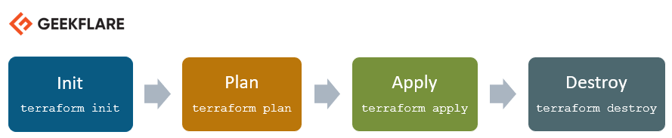
Terraform Lifecycle

Slide 7
Terraform init initializes the working directory which consists of all the configuration files
Terraform plan is used to create an execution plan to reach a desired state of the infrastructure. Changes in the configuration files are done in order to achieve the desired state.
Terraform apply then makes the changes in the infrastructure as defined in the plan, and the infrastructure comes to the desired state.
Terraform destroy is used to delete all the old infrastructure resources, which are marked tainted after the apply phase

Slide 8
How Terraform Works?
Terraform has two main components that make up its architecture:
Terraform Core
Providers

Slide 9
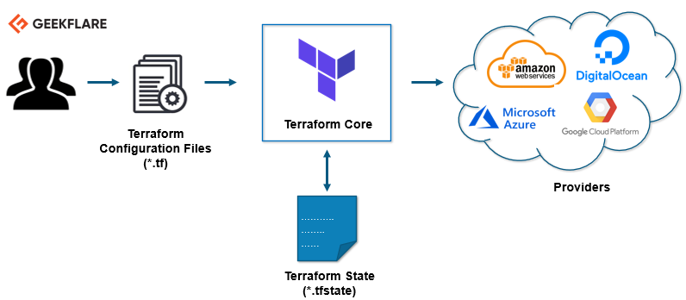
How Te

Slide 10
Terraform Core
Terraform core uses two input sources to do its job.
The first input source is a Terraform configuration that you, as a user, configure. Here, you define what needs to be created or provisioned. And the second input source is a state where terraform keeps the up-to-date state of how the current set up of the infrastructure looks like.
So, what terraform core does is it takes the input, and it figures out the plan of what needs to be done. It compares the state, what is the current state, and what is the configuration that you desire in the end result. It figures out what needs to be done to get to that desired state in the configuration file. It figures what needs to be created, what needs to be updated, what needs to be deleted to create and provision the infrastructure.

Slide 11
Install Terraform
Download the latest terraform package.
Refer to the official download page to get the latest version for the respective OS.
geekflare@geekflare:~$ wget https://releases.hashicorp.com/terraform/0.13.0/terraform_0.13.0_linux_amd64.zip
--2020-08-14 16:55:38--
https://releases.hashicorp.com/terraform/0.13.0/terraform_0.13.0_linux_amd64.zip
Resolving releases.hashicorp.com (releases.hashicorp.com)... 151.101.153.183, 2a04:4e42:24::439
Connecting to releases.hashicorp.com (releases.hashicorp.com)|151.101.153.183|:443... connected.
HTTP request sent, awaiting response... 200 OK
Length: 34851622 (33M) [application/zip]
Saving to: ‘terraform_0.13.0_linux_amd64.zip’
terraform_0.13.0_linux_amd64.zip
100%[=================================================================>] 33.24M
90.3KB/s in 5m 28s
2020-08-14 17:01:06 (104 KB/s) - ‘terraform_0.13.0_linux_amd64.zip’ saved [34851622/34851622]

Slide 12
Extract the downloaded package.
geekflare@geekflare:~$ unzip terraform_0.13.0_linux_amd64.zip
Archive:
terraform_0.13.0_linux_amd64.zip
inflating: terraform
Move the terraform executable file to the path shown below. Check the terraform version.
geekflare@geekflare:~$ sudo mv terraform /usr/local/bin/
[sudo] password for geekflare:
geekflare@geekflare:~$ terraform -v
Terraform v0.13.0

Slide 13
You can see these are the available commands in terraform for execution.
geekflare@geekflare:~$ terraform
Usage: terraform [-version] [-help] <command> [args]
The available commands for execution are listed below.
The most common, useful commands are shown first, followed by
less common or more advanced commands. If you're just getting
started with Terraform, stick with the common commands. For the
other commands, please read the help and docs before usage.
state Advanced state management

Slide 14
Provision AWS EC2 Instance Using Terraform
In this demo, I am going to launch a new AWS EC2 instance using Terraform.
Create a working directory for this Terraform demo.
geekflare@geekflare:~$ mkdir terraform_demo
Go to the directory and create a terraform configuration file where you define the provider and resources to launch an AWS EC2 instance.
geekflare@geekflare:~$ cd terraform_demo/
geekflare@geekflare:~/terraform_demo$ gedit awsec2.tf
Note: I have changed the access and secret keys 😛, you need to use your own.
From the configuration mentioned above, you can see I am mentioning the provider like AWS. Inside the provider, I am giving AWS user credentials and regions where the instance must be launched.
In resources, I am giving AMI details of Ubuntu (ami-0a634ae95e11c6f91) and mentioning the instance type should be t2.micro
You can see how easy and readable the configuration file is, even if you are not a die-hard coder.

Slide 15
provider "aws" {
access_key = "B5KG6Fe5GUKIATUF5UD"
secret_key = "R4gb65y56GBF6765ejYSJA4YtaZ+T6GY7H"
region = "us-west-2"
}
resource "aws_instance" "terraform_demo" {
ami = "ami-0a634ae95e11c6f91"
instance_type = "t2.micro"
}

Slide 16
terraform init
https://geekflare.com/terraform-for-beginners/

Slide 17
Terraform | Ansible
Terraform is a provisioning tool. | Ansible is a configuration management tool.
It follows a declarative Infrastructure as a Code approach. | It follows a procedural approach.
It is the best fit for orchestrating cloud services and setup cloud infrastructure from scratch. | It is mainly used for configuring servers with the right software and updates already configured resources.
Terraform does not support bare metal provisioning by default. | Ansible supports the provisioning of bare metal servers.
It does not provide better support in terms of packaging and templating. | It provides full support for packaging and templating.
It highly depends on lifecycle or state management. | It does not have lifecycle management at all.
Let’s see how Terraform vs. Ansible battle differentiates from each other:

Slide 18
Orchestration vs. Configuration Management
Terraform and Ansible have so many similarities and differences at the same time. The difference comes when we look at two significant concepts of DevOps: Orchestration and configuration management.
Configuration management tools solve the issues locally rather than replacing the system entirely. Ansible helps to configure each action and instrument and ensures smooth functioning without any damage or error. In addition, Ansible comes up with hybrid capabilities to perform both orchestration and replace infrastructure.
Orchestration tools ensure that an environment is in its desired state continuously. Terraform is explicitly designed to store the state of the domain. Whenever there is any glitch in the system, terraform automatically restores and computes the entire process in the system after reloading. It is the best fit in situations where a constant and invariable state is needed. Terraform Apply helps to resolve all anomalies effectively.
Let’s have a look at the Procedural and Declarative nature of Terraform and Ansible.

Slide 19
https://medium.com/geekculture/the-most-simplified-integration-of-ansible-and-terraform-49f130b9fc8

Slide 20
https://github.com/antonputra/tutorials/blob/main/lessons/014/main.tf
https://github.com/antonputra/tutorials/tree/main/lessons/014
https://github.com/EconomistDigitalSolutions/terraform-aws-ec2/blob/master/_main.tf

